Slide 1
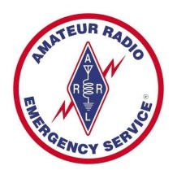

Amateur Radio
Emergency Services
(ARES)

Slide 2
Amateur Radio Emergency Services
What is Amateur Radio?
What is ARES?
Why use ARES?
When to use ARES
Served agencies
Final Thoughts

Slide 3
Amateur Radio Emergency Services
What is Amateur Radio?
  Amateur radio, commonly called "ham radio", is a hobby enjoyed by many people throughout the world (the latest statistics show about 3 million worldwide with740,000 in the USA).
  A holder of an Amateur Radio license has studied and passed required tests in his or her country and been issued a call sign by its government.

Slide 4
Amateur Radio Emergency Services
  This call sign is unique to the operator and is often a source of pride. The holder of a call sign uses it on the air to legally identify all voice and data communications.
  According to the Federal Communications Commission, the agency that regulates radio and telecommunications in the United States, amateur radio serves the following purposes:

Slide 5
Amateur Radio Emergency Services
    Promotion and enhancement of the Amateur Radio Service as a voluntary noncommercial public communications service.
    Continual advancement of the art of radio communication.
    Expansion of the reservoir of trained radio operators and electronic experts.
    Enhancement of international goodwill at the grass roots level.

Slide 6
Amateur Radio Emergency Services
  Amateur radio was organized by the ARRL (American Radio Relay League) over 100 years ago in 1914 by Hiriam Percy Maxim. The ARRL is the national association for Amateur Radio. The ARRL is the largest organization of radio amateurs in the world. ARRL's mission is based on five pillars: Public Service, Advocacy, Education, Technology, and Membership.

Slide 7
Amateur Radio Emergency Services
  Celebrity Amateurs
    Joe Rudi, Oakland A’s Ronnie Milsap, Singer
    Joe Walsh, Eagles Marlon Brando, Actor
    Chet Atkins, Singer King Hussein, Jordan
    Barry Goldwater, Senator Donnie Osmond, Singer
    Priscilla Presley, Actress Howard Hughes, Tycoon
    Astronauts, USA & others Tim Allen, Actor
    Walter Cronkite, Newscaster

Slide 8
Amateur Radio Emergency Services
What is ARES?
  The Amateur Radio Emergency Service® (ARES) consists of licensed amateurs who have voluntarily registered their qualifications and equipment, with their local ARES leadership, for communications duty in the public service and when disaster strikes.
  ARES consists of more than 40,000 licensed amateurs nationwide.

Slide 9
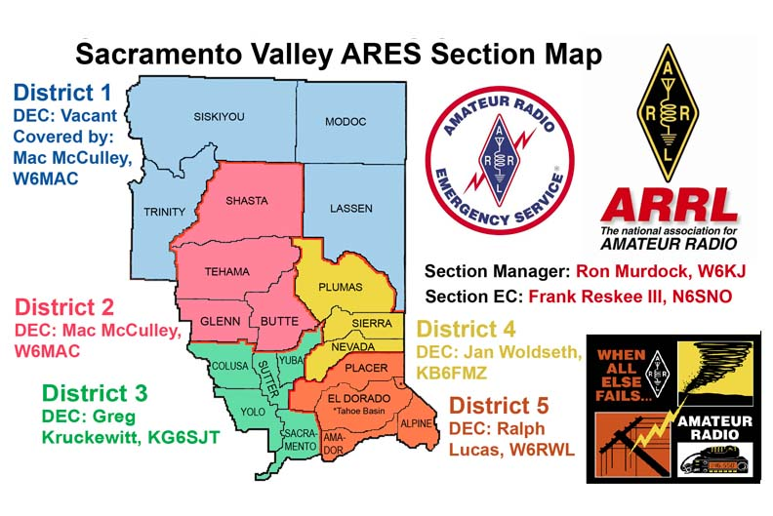
Amateur Radio Emergency Services

Slide 10
Amateur Radio Emergency Services
  There are over 400 ARES members within the section who have agreed to provide inter-county mutual assistance when needed. Regular drills are conducted by each county to simulate local and multi-county emergency situations.
  ARES members (and non-members) volunteer their time and equipment within their local communities for Bike-a-thons, Walks, Runs, and Races:
    Amgen Tour Bike Ride, Big Brothers/Big Sisters Bike Ride, Davis Double Century Bike Ride, AMBBR Bike Ride, Pony Express Re-ride, Nevada City Classic Bike Ride, Western States 100, 24 hour Agony Bike Ride, Gold Country Endurance Riders, Tevis Cup, BSM Triathlon.

Slide 11
Amateur Radio Emergency Services
Why use ARES?
  Backup resource
  Trained communicators
  We are volunteers (therefore FREE)
  Come with our own equipment
  We have communication capability in the 3-50MHz (HF), 144MHz (VHF), 440MHz (UHF) range. Modes include voice, and digital (e.g. packet, Winlink, Fldigi). Our digital capability allows for email access without the need for the internet. We have our own UHF and VHF repeaters with battery backup and the ability to set up portable repeaters as needed.

Slide 12
Amateur Radio Emergency Services
  Regular use of ARES personnel in your drills will guarantee a viable backup communications resource when needed.
  Our Section Leadership (ECs, DECs, and SEC) meets on a semi-regular basis to discuss and plan drills, interoperability and mutual aid scenarios beneficial to our served agencies.

Slide 13
Amateur Radio Emergency Services
When to use ARES?
  Area-wide disasters (e.g. wildfire, flood, earthquake) resulting in widespread damage to:
    Power
    Phone-lines
    Cell Service
    Property
  Disasters impact people
    Food, shelter, clothing, medicine, security
    Communication with family

Slide 14
Amateur Radio Emergency Services
Served agencies
  EOC- Vic Ferrera
    The EOC serves as the ARES base of operations where we provide backup communications to/from the county as needed.
  Red Cross – Pete Santiago/Michelle Perkins
    Provide communications to the county, other shelters, & Red Cross leadership
  Hospitals
    Provide communications to the county and other hospitals.
  Small animal rescue
    Provide backup communications

Slide 15

Amateur Radio Emergency Services
Final Thoughts
  Please use us. Include us in your drill plans. We can help and we’re free.
  Short Video: Amateur radio today - hosted by Walter Cronkite.

Slide 16
Amateur Radio Emergency Services
  Rich Vizcarra K6TM
  EC, Nevada County ARES
  http://www.n1oes.org
  k6tm@n1oes.org
  916-799-1806
  Packet messaging: k6tm@AG6QO.#nca.ca.usa.noam

